Slide 1
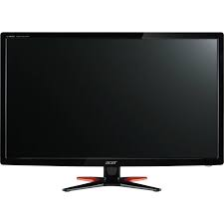

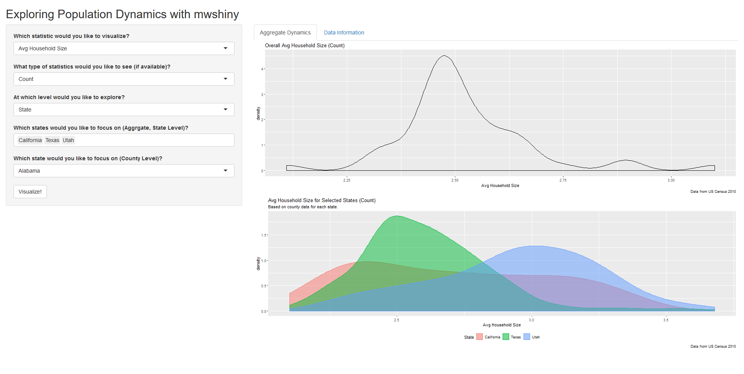
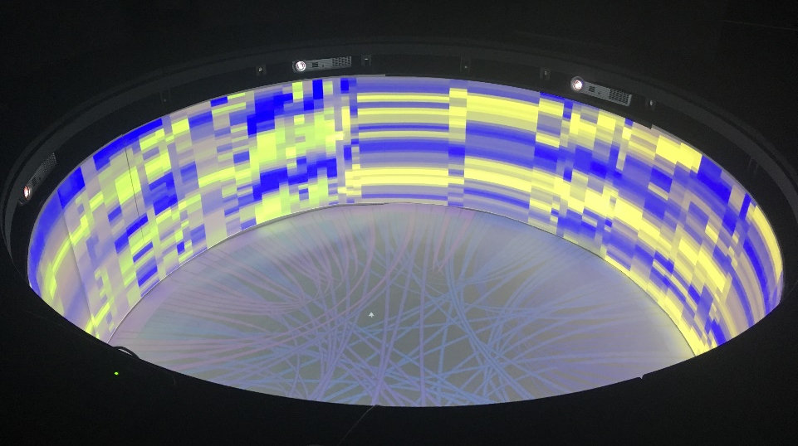
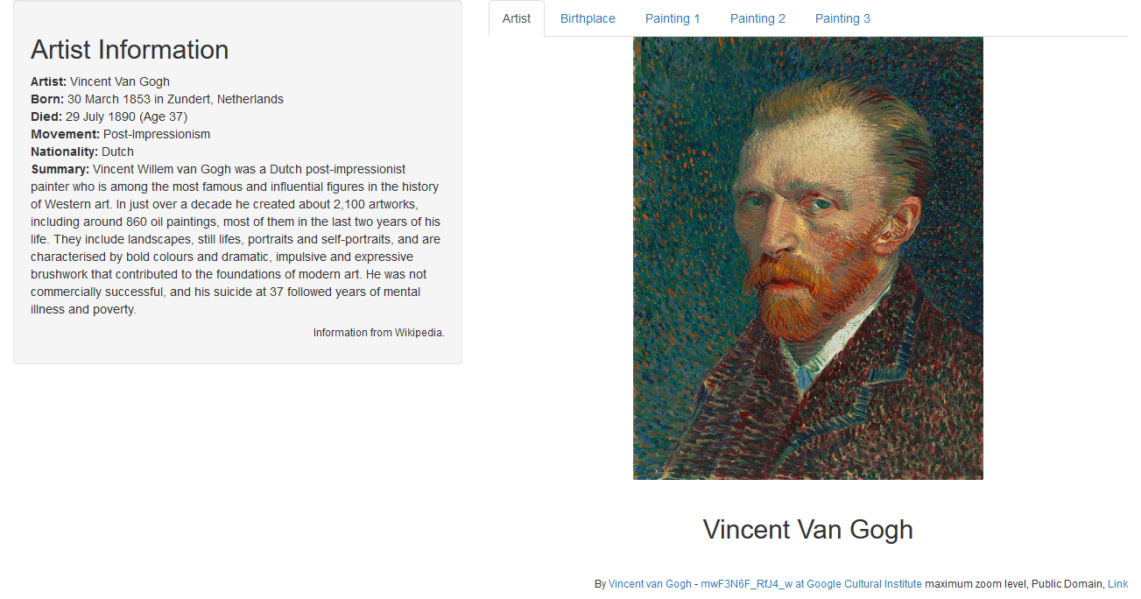
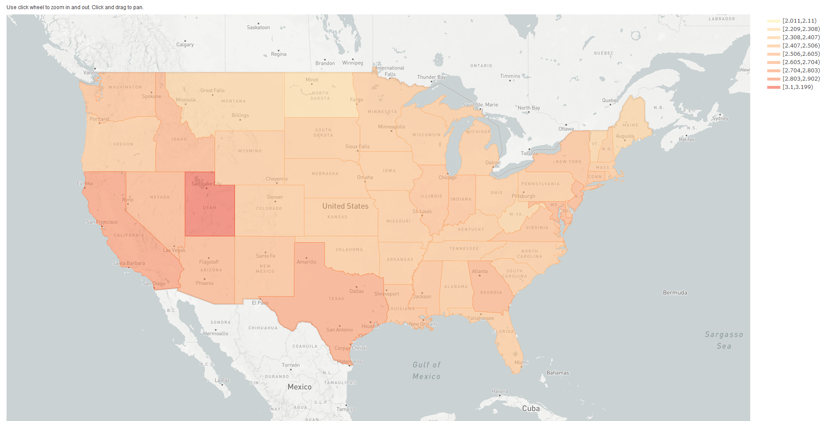
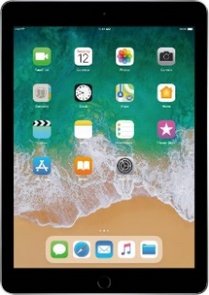
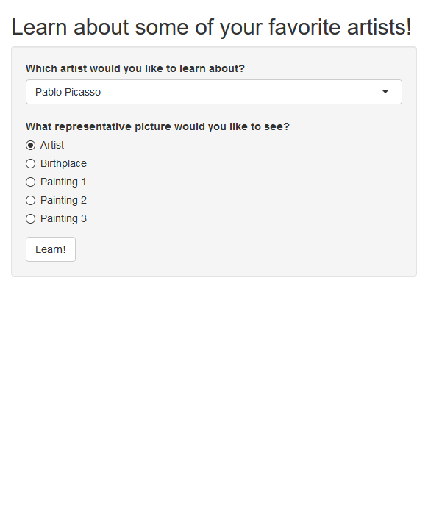
mwshiny: Connecting Shiny Across Multiple Windows
By Hannah De los Santos, John Erickson, Kristin P. Bennett
Rensselaer Polytechnic Institute
Notes:
Hi everyone! Thank you to Aline for introducing me and all of you for being here. My name is Hannah De los Santos, and I’ll be presenting on mwshiny, a package to connect Shiny applications across multiple windows.
(SLOW DOWN, BREATHE)

Slide 2
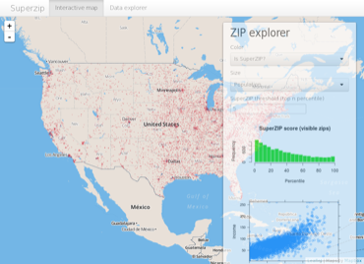
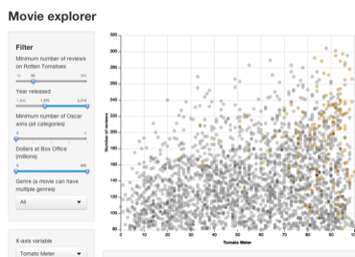
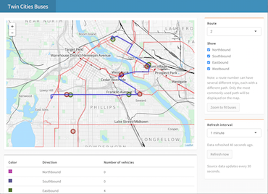

What is Shiny?
Shiny lets users develop interactive web applications (apps) with only R
app.R
ui
server(input, output, session)
shinyApp(ui, server)
Examples from RStudio Shiny Gallery: https://shiny.rstudio.com/gallery/
Notes:
As you all likely know, since you’re here, Shiny is a great package for R users that lets them develop interactive web applications without the need for learning web development languages, such as HTML and CSS.
In R (CLICK), Shiny apps are structured through UI and server functionality, where the UI variable contains the front-end, user-facing functionality and inputs. The server function takes user input and renders output accordingly.
(CLICK) This creates interesting, malleable interfaces that can make a variety of topics accessible: population dynamics, transportation routes, and even movies.

Slide 3
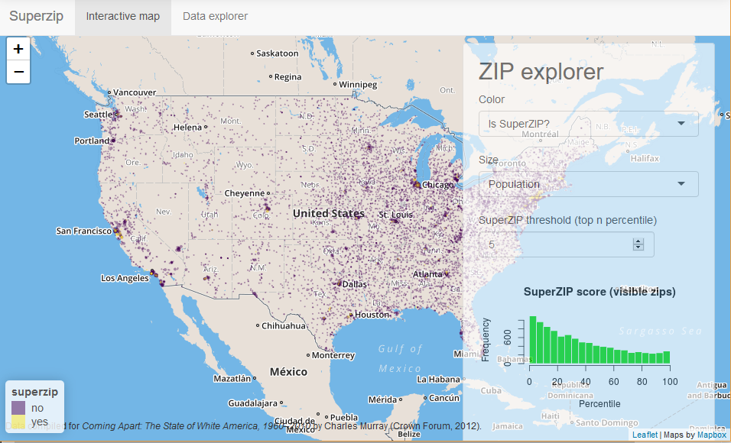
A Problem: Shiny apps have only one window!
Shiny apps only span one window, and space is limited
You can alleviate this problem by adding separate tabs, but it’s difficult to compare outputs
Examples from RStudio Shiny Gallery: https://shiny.rstudio.com/gallery/
Notes:
Despite the variety of topics, all of the examples I just showed you have one thing in common: they span only one window! And when you have a lot of inputs and outputs, this can get quite crowded, and ever more confusing.
(CLICK) You can alleviate this slightly by adding separate tabs, but in that way, it’s difficult to compare outputs directly.

Slide 4
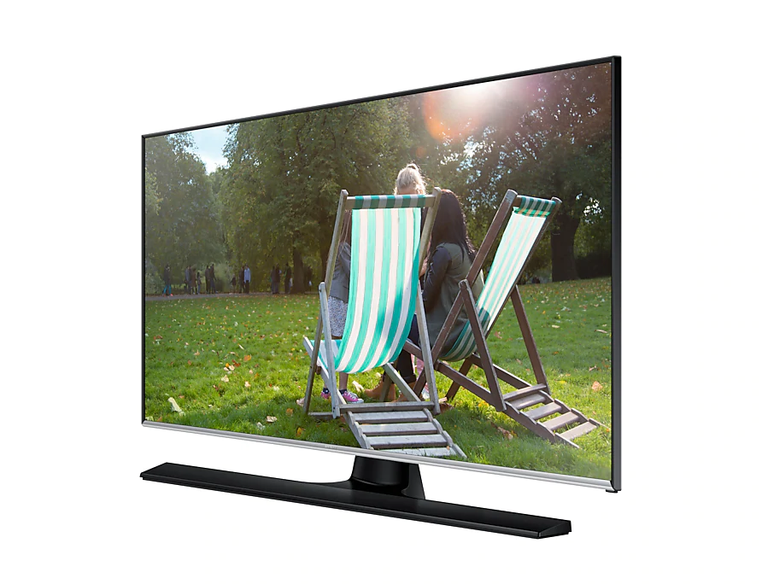

We Live In a Multi-Monitor World
Multiple Monitors at a Workstation
Controller Driving External Monitor
Notes:
Further, we are increasingly living in a multi-monitor world. How many of you have at least two monitors at your workstation, or at home? A fair amount, right? So we propose to take advantage of that, letting Shiny apps be connected across multiple monitors. Another situation we can think of is an external controller directing inputs for a visualization-focused monitor.
So how do we address this problem? We use multi-window shiny!

Slide 5
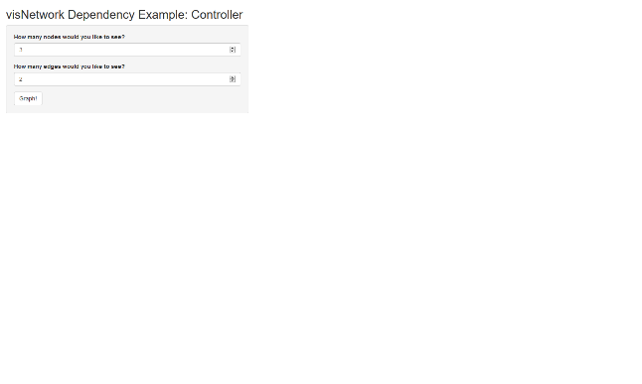
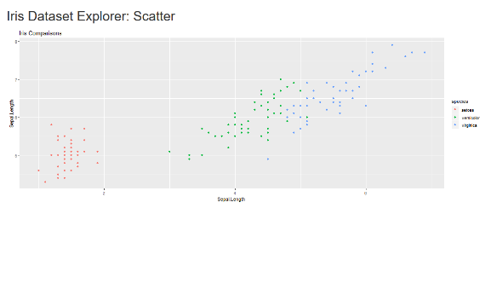
mwshiny: Multi-Window Shiny
mwshiny extends Shiny across multiple separate windows
Uses Shiny’s syntax and conventions, so not much additionally to learn
mwshiny does this by breaking app development into an easy workflow:
User Interface Development
Server Computation
Server Output
On CRAN as: mwshiny
Notes:
Mwshiny, or Multi-Window Shiny, extends Shiny across multiple windows, extending the interface easily. It uses Shiny’s familiar syntax and conventions, so it’s pretty easy to pick up for anyone who’s already learned shiny.
Multi-window shiny does this by breaking down app development into 3 parts: user interface development, server computation, and server output.

Slide 6
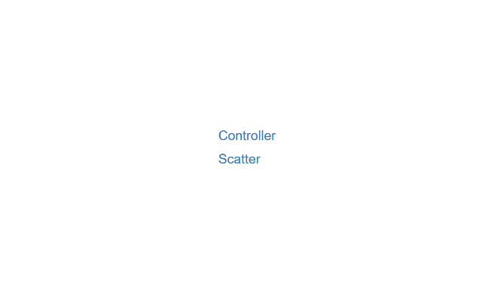
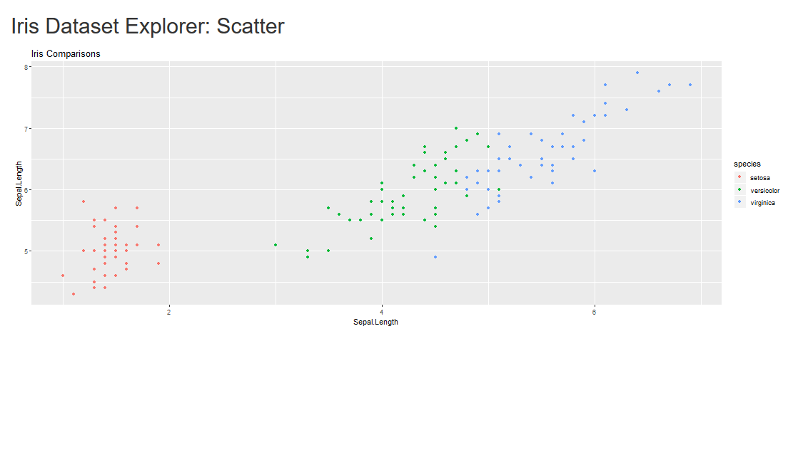
Mwshiny: User Interface Development
Specify each window with user interface arguments:
Window titles (win_titles): a vector of strings
User interfaces (ui_win): a list of traditional Shiny UIs corresponding to each title
Example:
win_titles <- c("Controller","Scatter")
ui_win <- list()
ui_win[[1]] <- fluidPage(…) # controller
ui_win[[2]] <- fluidPage(…) # scatter
Notes:
Our multi-window environment begins by specifying the user interface for each of the windows – what the user sees on each window. This is done through the window titles and user interface arguments. These are win_titles, a vector of strings specifying the name of each window, and ui_win, a list that contains the traditional shiny UIs corresponding to each title.
In this example, we have two windows, called controller and scatter (CLICK) – when we run our multi-window shiny app, we see that window on the top right. Then we define the user interfaces for each of the corresponding windows (CLICK) – the first for what we call the controller, and the next for the scatter.
---
MAYBE CLARIFY HERE

Slide 7
mwshiny: Server Calculations
Observe events and create variables for output to be rendered:
Server calculations (serv_calc): a list of functions of the form function(calc, sess), where:
calc: reactive variable that contains Shiny input variables, as well as a place to put calculated variables
sess: traditional Shiny server session variable
Example:
serv_calc <- list()
serv_calc[[1]] <- function(calc, sess){
observeEvent(calc$go, {
calc[["sub.df"]] <- data.frame(calc$go)
})
}
Notes:
Next, we move on to what we call our server calculations, where we observe events and create variables for output to be rendered. This is a list of functions of the form function calc, sess, where calc is a reactive variable that contains all the Shiny input variables, as well as a place to put any derived variables we use in output, and sess, which is just the traditional shiny server session variable.
In this example, we observe when our input “go” changes, and then create our dataframe accordingly, adding it to our calc variable.

Slide 8
mwshiny: Server Output
Render output based on input and calculated variables:
Server output (serv_out): a named list of functions of the form function(calc, sess), which returns a render() result, and is named corresponding to the output ID
Example:
serv_out <- list()
serv_out[["iris_scatter"]] <- function(calc, sess){
renderPlot({
if (!is.null(calc$sub.df)){
ggplot(calc$sub.df)…
}
})
}
Notes:
We then finally come to our server output, which is named list of functions of the same previous form, which returns a render result corresponding to the output ID.
In our example, we render our scatter plot based on our calculated dataframe, and return that in our function.

Slide 9
mwshiny: Breaking Down the Workflow
User Interface Development
Server Computation
Server Output
mwsApp(win_titles, ui_win, serv_calc, serv_out, depend)
Separating server into computation and output clarifies workflow
Enhanced by list and function structure of mwsApp() variables
Notes:
After you have all three pieces, you pass them into the mwsApp function, along with stated javascript and CSS dependencies, and it runs your multi-window shiny app!
By separating the traditional server section into computation and output, we force increased clarity of the workflow, breaking the computation into manageable, smaller chunks. This is also enhanced by the function and list structure of serv_out and serv_calc, which also encourage code chunkiness.

Slide 10
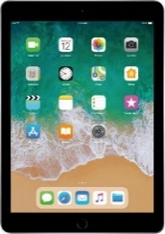
Examining mwshiny’s Workflow Through Three Case Studies
Case 1:
Case 2:
Case 3:
Multiple Monitors at a Workstation
Alternative Visualization Structures
Controller Driving External Monitor
Download scripts on Github: https://github.com/delosh653/mwshiny-examples
Notes:
In order to demonstrate the efficacy of multi-window shiny and its workflow, we show three simple case studies: multiple monitors at a workstation, a controller driving an external monitor, and an alternative visualization structure.

Slide 11
Case 1: Examining Population Dynamics Using Two Monitors
Use 2010 US Census to examine population statistics at state and county levels
Begin by defining our user interfaces for each window:
win_titles <- c("Controller", "Map")
ui_list <- list()
ui_list[["Controller"]] <- fluidPage(…
sidebarLayout(
sidebarPanel(
selectInput("stat", "Which statistic would you like to visualize?", choices = stat_choi),…
actionButton("go", "Visualize!")),
mainPanel(
tabsetPanel(
tabPanel("Aggregate Dynamics",
plotOutput("overall_dens"), …
),…))))
ui_list[["Map"]] <- fluidPage(
…
plotlyOutput("map", height = "1000px"),
…
)
Download scripts on Github: https://github.com/delosh653/mwshiny-examples
Notes:
We first look at the first case study, a simple two monitor situation to visualize population dynamics. Using the 2010 US census of the continental US, we want to compare overall levels of various statistics to specific statistics at both a state and county level.
We start with the first stage of our workflow: defining our user interface. In this case, (CLICK) I want two windows, which I call controller and map. (CLICK) The first user interface specifies user inputs, as well as several density plots, while (CLICK) the other simply shows the map, colored by the chosen statistic.
----
Add here

Slide 12
Case 1: Server Calculations
We then calculate variables based on which states or counties we’ve chosen that are required for visualizations:
These will be used in rendering our plots
serv_calc <- list()
serv_calc[[1]] <- function(calc, sess){
observeEvent(calc$go, {
…
calc[["over_df"]] <- …
calc[["state_df"]] <- …
calc[["merge_pop"]] <- …
…
})
}
Download scripts on Github: https://github.com/delosh653/mwshiny-examples
Notes:
Now that I’ve determined what I want my users to see, I have to actually calculate what I need for my visualizations based on this input. I added an action button to my input, so that I only want it to generate visualizations when the user specifies.
I’m not going to go too into the weeds on this (if you want to check out the code for all these examples, it’s at my Github at that link on the bottom), but I do this through my calculate function, which only contains our observeEvent function to trigger on the button click. When that happens, we add data frames to our calc list to be used by our various plot renders.

Slide 13
Case 1: Server Output
In this case, we have our three outputs based on these calculations:
serv_out <- list()
serv_out[["map"]] <- function(calc, sess){
renderPlotly({
calc$merge_pop %>%
group_by(group) %>%
plot_mapbox()...
})
}
serv_out[["overall_dens"]] <- function(calc, sess){
renderPlot({
ggplot(calc$over_df,…)+
...
})
}
serv_out[[“state_dens"]] <- function(calc, sess){
renderPlot({
ggplot(calc$state_df,…)+
...
})
}
Download scripts on Github: https://github.com/delosh653/mwshiny-examples
Notes:
After we’ve calculated based on inputs, we can render our three different objects: (CLICK) a density plot based on an aggregate of all the states together, (CLICK) a density plot comparing the county level data of selected states, and (CLICK) a map colored by our specific statistic.

Slide 14
Case 1: Result
Putting all this together, we end up with our multi-monitor system:
Download scripts on Github: https://github.com/delosh653/mwshiny-examples
Notes:
Once we put all these parts together, we end up with our double-monitor shiny app, where we can compare the discrete statistics for each state on the map with the overall trends. Multi-window shiny allows us to easily take advantage of our expanded screen real estate to make comparisons between large plots on the fly, without being compressed to one screen.

Slide 15


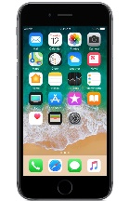
Case 2: Using an External Controller to Drive Cultural Awareness
We next have a controller (phone, tablet) driving an external monitor in an art museum, so patrons can learn more about their favorite artists
Begin by defining UI:
win_titles <- c("Controller", “Art_Monitor")
ui_list <- list()
Inputs
Outputs
ui_list[["Controller"]] <- fluidPage(…
sidebarLayout(
sidebarPanel(
selectInput("art_wait", …), …)))
ui_list[["Art_Monitor"]] <- fluidPage(…
htmlOutput("info") …
… tabPanel("Artist", … htmlOutput("artist"))
)
Download scripts on Github: https://github.com/delosh653/mwshiny-examples
Notes:
Now that we’ve shown a basic two monitor situation, we move to the next two monitor situation: a controller driving an external monitor. Though these largely show the same set up, the goal is very different from the workspace monitor situation.
To illustrate this example, we look at the case of someone seeking to learn more about their favorite artists in a museum. Information is displayed on an external monitor for the user, and the user has access to either a separate tablet in front of the monitor or their own phone where they can make choices.
As with any multi-window shiny workflow, we start by defining our user interface. (CLICK) It’s very similar to the last, with two windows – however, the large difference comes from the way we want to set up each of these UI’s: (CLICK) our controller window exclusively has user inputs, (CLICK) while our art monitor has exclusively output.

Slide 16
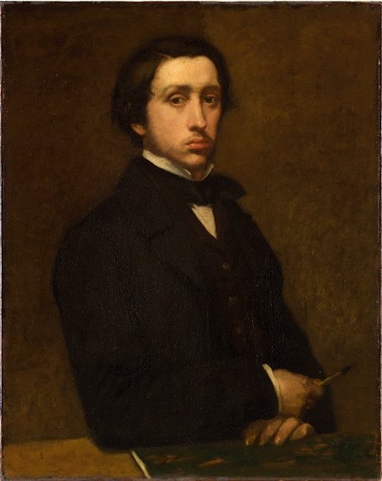
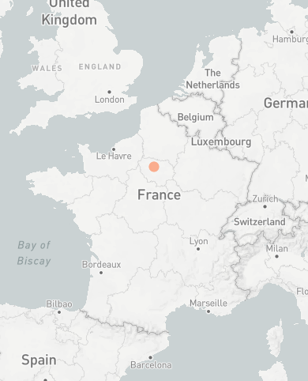
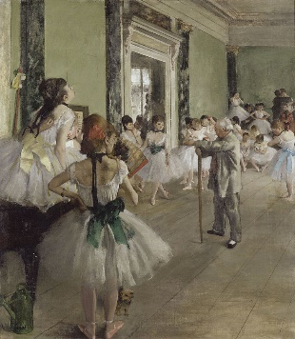
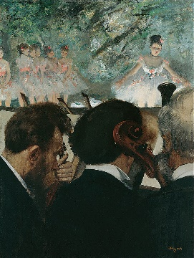
Case 2: Server Computation and Server Output
Server Computation
Server Outputs
serv_out <- list()
serv_out[["info"]] <-
function(calc, sess){…}
serv_out[[“artist"]] <- …
serv_out[[“painting_1"]] <- …
serv_out[[“painting_2"]] <- …
serv_out[[“painting_3"]] <- …
serv_out[[“map"]] <- …
serv_calc <- list()
serv_calc[[1]] <- function(calc, sess){
observeEvent(calc$go, {
calc[["select_tab"]] <- calc$which_tab
calc[["art_person"]] <- calc$art_wait
calc[["art_born"]] <- artist_info…
updateTabsetPanel(sess, "art",
selected = calc$select_tab)
})
}
Information from Wikipedia
Download scripts on Github: https://github.com/delosh653/mwshiny-examples
Notes:
Since the purpose of this app is largely to display information, our computation section is relatively small. However, here it is important to note that in this computation, we’re also allowing the user to choose what they see with the updateTabsetPanel function every time they want to see something new – this allows no need for interaction directly through the monitor.
On the output side, however, we have a lot of different information to render based on the artist and aspect the user wants to see, including the artist’s birthplace and some representative paintings.

Slide 17
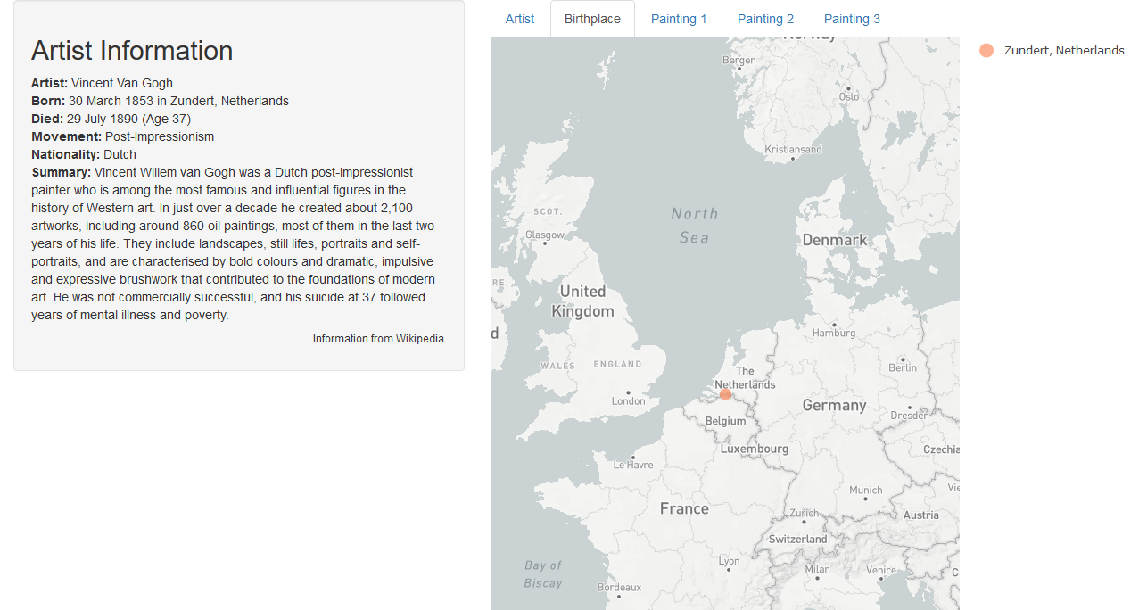
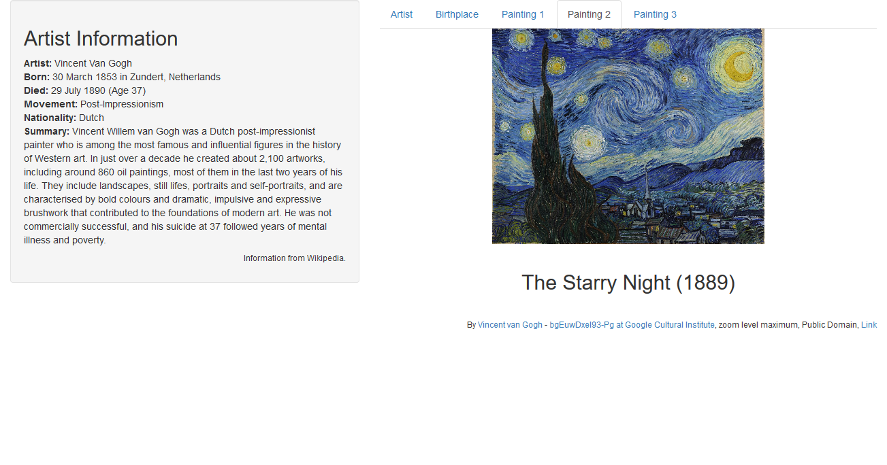

Case 2: Result
With all these pieces, we end up with our ideal monitor control situation:
Information from Wikipedia
Download scripts on Github: https://github.com/delosh653/mwshiny-examples
Notes:
Once we put all the pieces together, we end up with our ideal monitor control situation, where a separate controller window controls the output for our monitor window, showing the artist information and representative pictures of our example artist, Van Gogh. Thus, in this way, R shiny can be used to power controller-driven applications for any variety of topics.

Slide 18
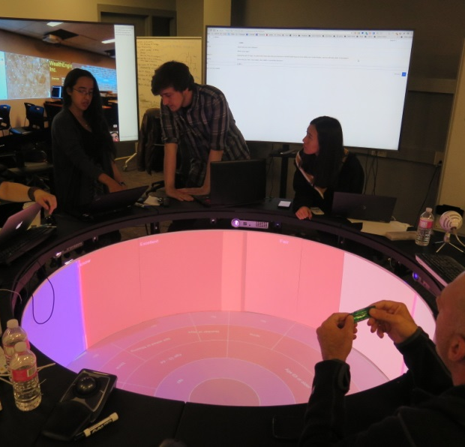
Case 3: An Immersive Shiny Application with the Rensselaer Campfire
The Rensselaer Campfire’s 3D structure enhances knowledge discovery by reducing cognitive load
Users surround and interact with the Campfire to explore their data
rectangular wall
circular floor
Download scripts on Github: https://github.com/delosh653/mwshiny-examples
Notes:
For our last case study, we’ll move to something completely different: multi-window shiny to work on alternative visualization method: the Rensselaer Campfire, developed at my school, RPI.
The campfire, a cylindrical 3D structure consists of a circular floor and a rectangular wall wrapping around the floor. When we break this down, (CLICK) we can see the two monitors creating the campfire more clearly – a circle and a rectangle. Since the campfire structure handles all the window warping, all we have to think about is dealing with these as two monitors. We also have access to as a controller to initialize visualization.
(CLICK) Users surround and interact with the campfire to explore their data.
By using this 3D structure, we increase collaboration and enhance innovation. We also reduce cognitive load – that is, by having the ability to see data in a 3d fashion, it becomes easier to compare disparate sets of data.

Slide 19
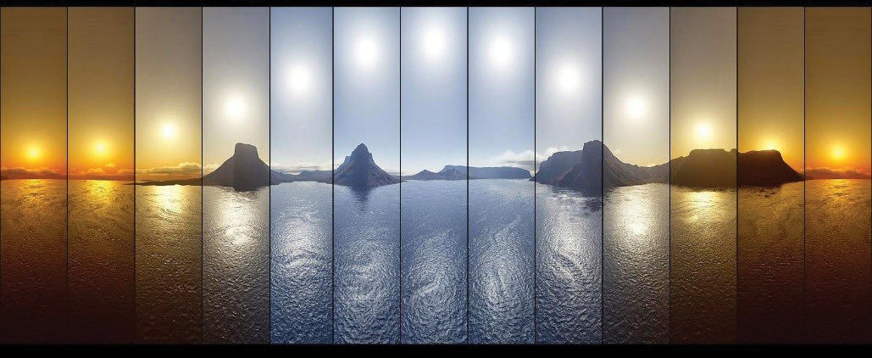
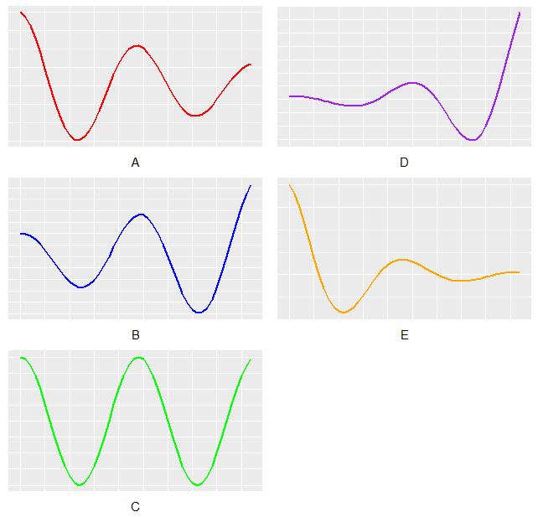
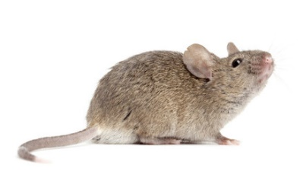
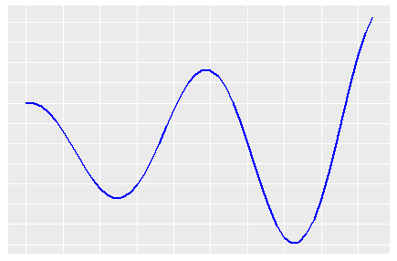
Case 3: Using the Campfire to Explore Circadian Rhythm Data
In this case study, we use the Campfire to explore the function of circadian rhythms:
~24-hour cycles reinforced by external cues (light)
In mouse data, they are amplitude-changing cosine waves
Interrupting rhythms leads to increased health risk of many diseases (cancer, diabetes, etc.)
Use the Campfire to explore different functions of circadian genes and how they interact with each other
Harmonic
Forced
Damped
ENCORE application: https://github.com/delosh653/ENCORE
Download scripts on Github: https://github.com/delosh653/mwshiny-examples
Notes:
Using the campfire, we’re going to examine something that impacts health for all of us: circadian rhythms. Circadian rhythms are roughly 24-hour cycles that are reinforced by external cues, such as light.
In data from organisms such as mice, they look like cyclic cosine waves that can change amplitude over time, which we can categorize based on their amplitude.
When we interrupt these rhythms, it can lead to an increased risk of many health problems, such as cancer and diabetes.
Once we identify these rhythms, we want to know their function and how they interact with each other within their amplitude changing categories, in the hopes of isolating root causes of dysfunction.
This application is based on the ENCORE methodology, which you can find on GitHub.

Slide 20
Case 3: User Interface Development
As always, we begin with what we want our user interfaces to look like:
win_titles <- c("Controller", “Wall", “Floor")
ui_list <- list()
ui_win[["Controller"]] <- fluidPage(
h2("Explore the function of circadian rhythms using the campfire!"),
sidebarLayout(
sidebarPanel(
selectInput("new_path", "Which GO Term would you like to examine?",
choices = c("metabolic process" = "GO:0008152", …))
),
mainPanel()
)
)
ui_win[["Wall"]] <- div(
d3Output("wall", height = "663px")
)
ui_win[["Floor"]] <- div(
d3Output("floor", height = "895px")
)
Download scripts on Github: https://github.com/delosh653/mwshiny-examples
Notes:
As always, we begin with what we want our user interface to look like. In this case, (CLICK) we have three windows to manage: (CLICK) our simple controller, where we select the gene function we want, and our floor (CLICK) and wall (CLICK). The floor is simply going to display our chord diagram of interacting genes, and the wall will have a heatmap of what our expression looks like over time with each gene.

Slide 21
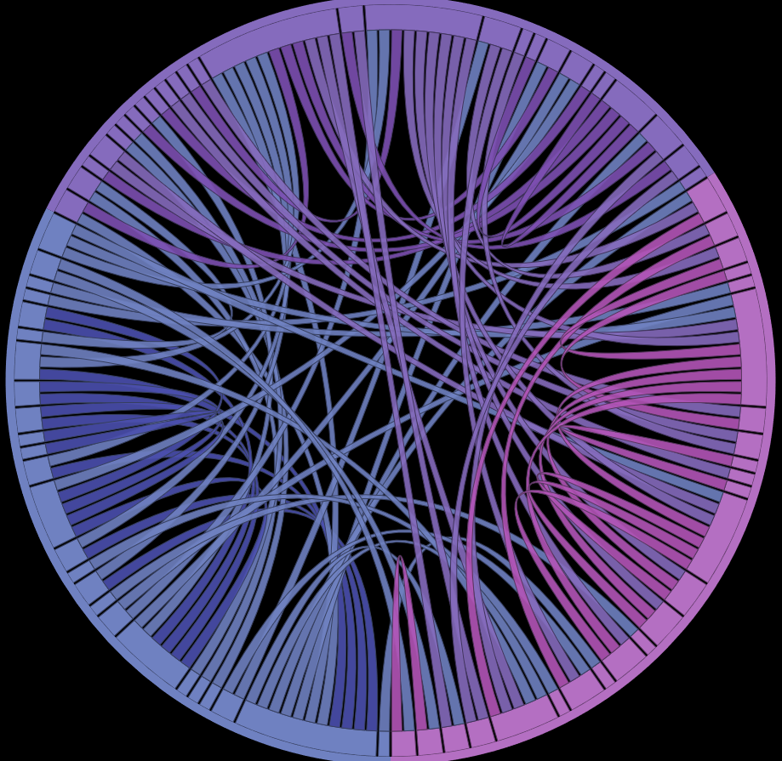
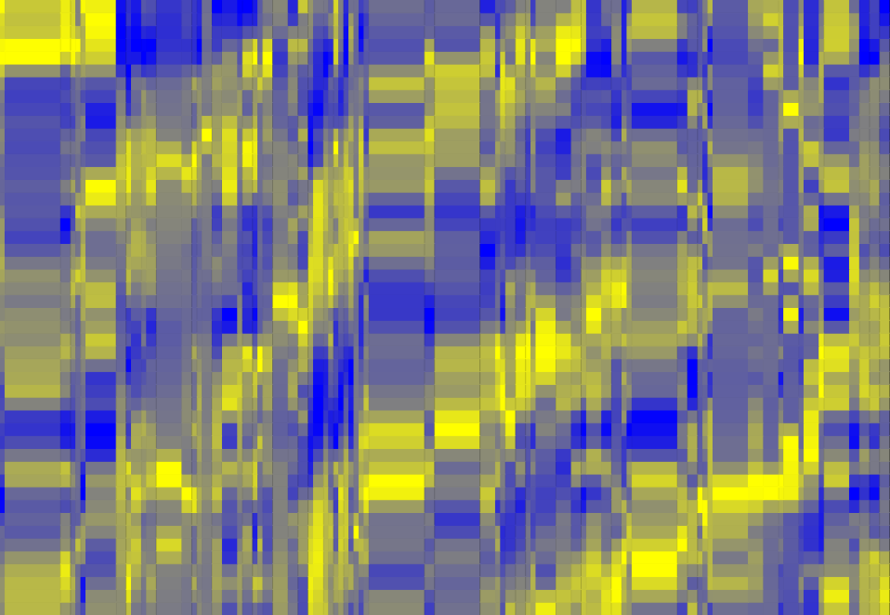
Case 3: Server Calculations and Output
Server Computation
Server Outputs
serv_calc <- list()
serv_calc[[1]] <- function(serverValues, sess){
observeEvent(serverValues$new_path, {…})
}
serv_calc[[2]] <- function(serverValues, sess){
observeEvent(serverValues$dark, {…})
}
serv_calc[[3]] <- function(serverValues, sess){
observeEvent(serverValues$undark, {…})
}
serv_out <- list()
serv_out[[“wall"]] <-
function(calc, sess){…}
serv_out[[“floor"]] <- …
Data from Hughes, et al. (2009)
Download scripts on Github: https://github.com/delosh653/mwshiny-examples
Notes:
Once we have our user interfaces in order, we can develop our calculations based on input. Once a user’s selected a gene function, we create the data for the chord diagram and heat map.
Since have the ability to have mouse interaction in the campfire, we also have other calculations to trigger on hovering on different chords, which change the visualization in the Campfire accordingly. We’ve added these observations as a separate calculations in the computation section.
After we’ve made all our computations, we simply render our output in our serv_out list, with the wall showing our heatmap for each gene, with yellow as high expression and blue as low expression, and our floor showing the interaction presence between each gene set.

Slide 22
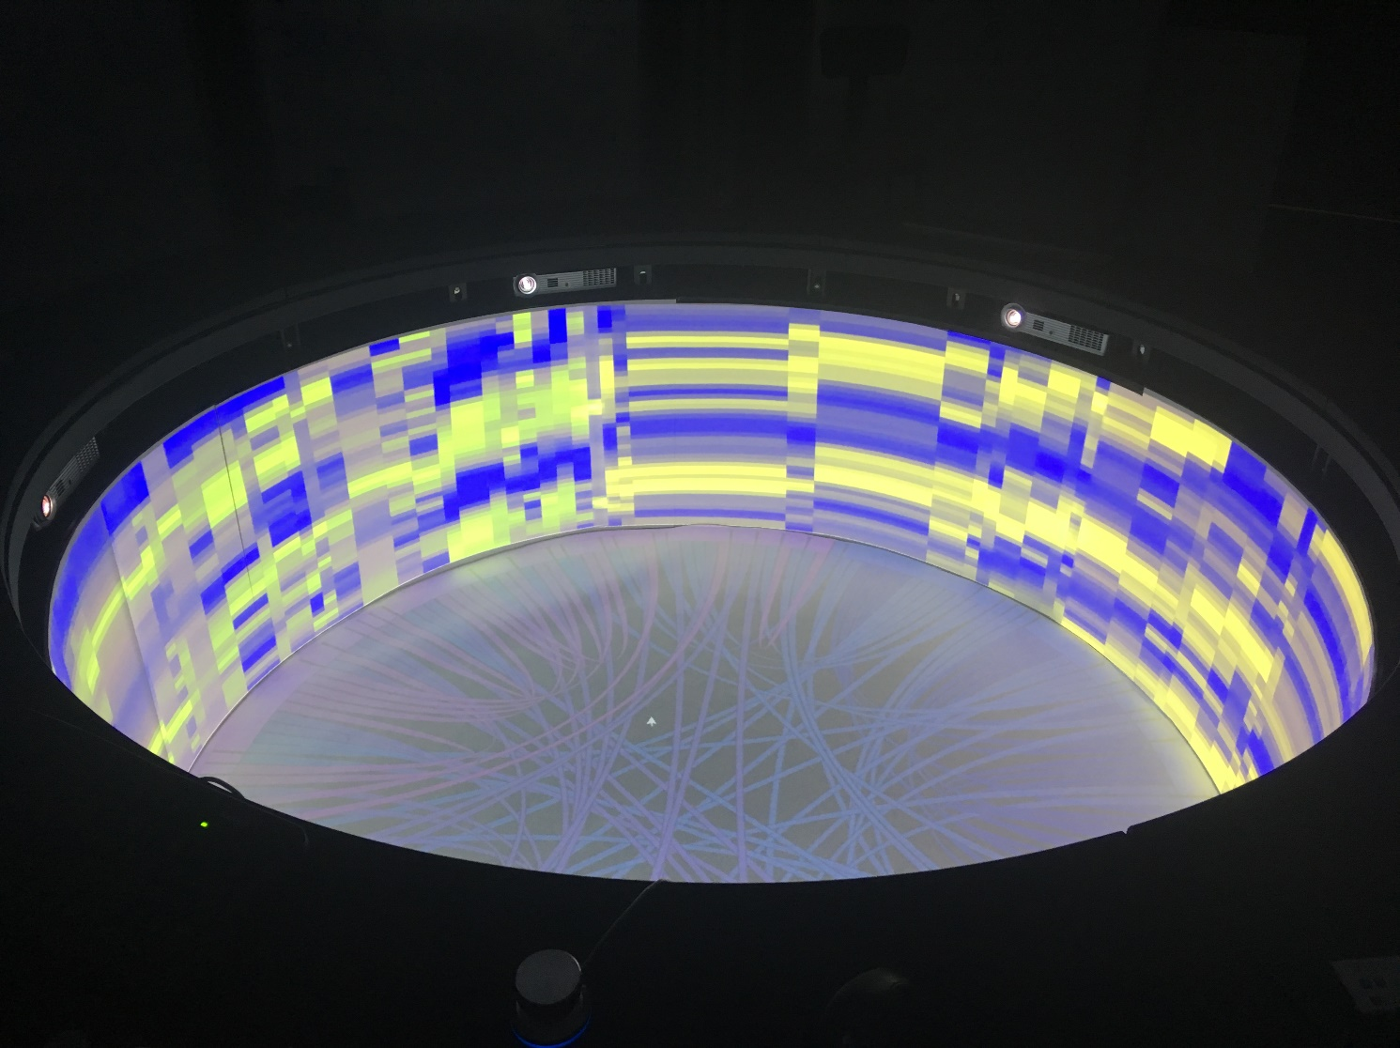
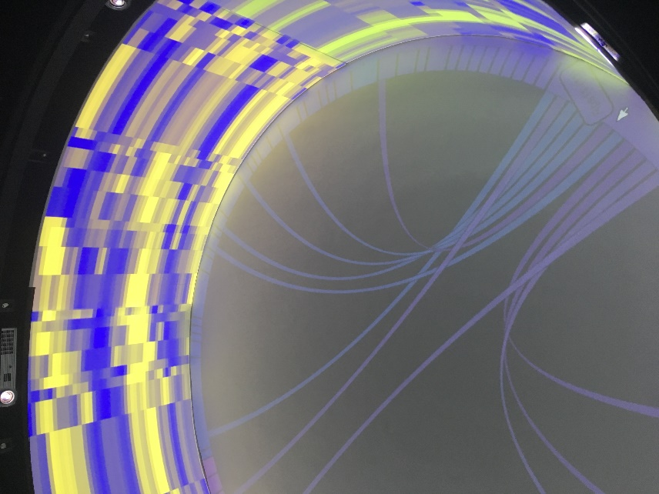
Case 3: Result
Once we’ve gone through our workflow, we can see our example for the function “metabolic process” in the Campfire:
Hovering to see connections for Rps11
Full Campfire
Data from Hughes, et al. (2009)
Download scripts on Github: https://github.com/delosh653/mwshiny-examples
Notes:
So once we’ve put all the pieces together from our workflow, we can see our example for the function “metabolic process” in the Campfire. We can also hover on specific genes to focus on their connections, so that we can figure out which genes are highly connected, or influencing, other genes. For example, we’ve hovered over Rps11, which has 11 gene connections, more than many of the genes represented. Users can continue to explore genes in this way, collaborating to discover ever more information through the 3D structure.
----
Yes there is a mistake on this slide and I know it

Slide 23

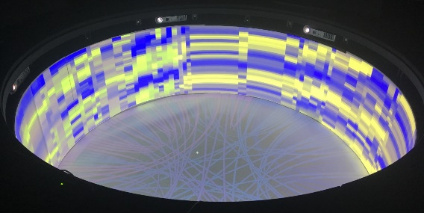
Summary: Multi-Window Shiny (mwshiny)
mwshiny extends standard Shiny to have multiple windows
mwshiny requires a breaks down Shiny workflow further to increase clarity
Presented mwshiny’s efficacy in three scenarios:
Multi-monitor systems (U.S. Population Dynamics)
Controller-driven monitor (Art Cultural Exploration)
Alternative visualizations in the Campfire (Circadian Rhythm Function)
User Interface Development
Server Computation
Server Output
Notes:
So just as a quick summary of what we’ve talked about: we introduced the package, mwshiny, which extends standard shiny to have multiple windows and we developed a workflow for these multi-window shiny apps which increased clarity.
We then presented three different simple case studies in three different fields: multimonitor systems illustrating population dynamics, a controller driving situation increasing cultural awareness, and an alternative visualization in the campfire illustrating the impact of circadian rhythms on gene function. These case studies show the impact of mwshiny as we move into a future with ever more immersive applications and structures.

Slide 24

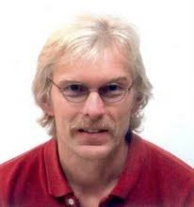
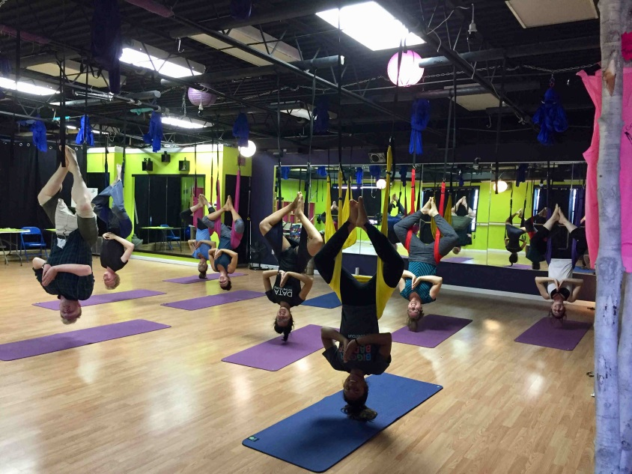



Acknowledgements
Thank you!
Hurley lab: Jennifer Hurley, Emily Collins, Meaghan Jankowski
IDEA lab: Kristin Bennett, John Erickson
Support:
National Science Foundation
Rensselaer Polytechnic Institute
National Institutes of Health
The Hurley lab hangin’ out.
Notes:
I’d like to thank the Hurley lab for all their support and feedback; and the IDEA lab, including Kristin Bennett, my advisor, and John Erickson, who helped work on this project in the Campfire. This work is supported by the NSF, RPI, and the NIH.
Thank you all very much for listening, and does anyone have any questions?

